Slide 1


<Alberto Terranova>
<31.05.2022>

Slide 2

Outline
Executive Summary
Introduction
Methodology
Results
Conclusion
Appendix

Slide 3
Executive Summary
Methodology:
Data Collection: SpaceX API, and Web-Scraping from SpaceX Wikipedia page.
Data Wrangling:
Missing Data were imputed with mean values
Binary Classification: 0-1 unsuccesful-succesful landing
Exploratory Data Analysis (EDA):
SQL – for Database analytics
Folium – for visual analysis
Predictive Analysis:
Logistic Regression
Support Vector Machine
Decision Tree
K-Nearest Neighbors

Slide 4
Executive Summary
Results predictive analysis:
All four models in the previous slide achieved similar testing accuracy (83.3%) with a prediction accuracy varying in the range of 84-87%
However more data is required for more comprehensive studies.

Slide 5
Introduction
SpaceX’s costs for launching Falcon9 rockets is roughly $62m, which is almost 3x cheaper than NASA’s. This is partially due to the fact SpaceX’s technology allows for re-usage of landed rockets.
The aim of this project was to determine whether SpaceX Falcon9 first stage would land successfully or not.
Business-wise if a rocket will land, then one can determine the cost of a launch and use this information to infer whether or not a company should or shouldn’t enter the market.

Slide 6

Section 1

Slide 7
Data Collection REST API
Two methods were used for data collection:
1. Using the SpaceX REST API one retrieves important information about the rocket, payload, landing outcome etc.
2. The main function used to retrieve data and convert then to a json file is:
- requests.get("https://api.spacexdata.com/v4/*/"+str()).json()
Where * is replaced by the attribute e.g. rockets, launchpads, payloads, cores, launches
3. After retrieving information in a json format, they get converted into a panda dataframe calling the method “pandas.json_normalize()”
4. Data is then filtered to include only Falcon9 launches and Payload missing values inputed with the mean

Slide 8
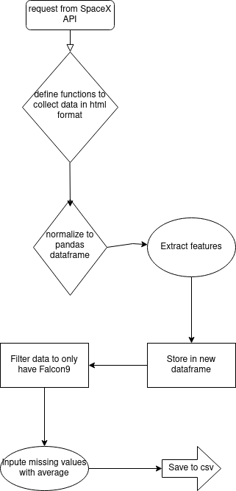
Data Collection – SpaceX API
https://github.com/albertoterranova/IBM/blob/main/1%20-%20Data_collection_API.ipynb
Here you can find the notebook

Slide 9
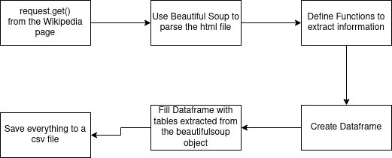
Data Collection - Scraping
Here is the link to the github notebook
https://github.com/albertoterranova/IBM/blob/main/2%20-%20Data_Collection_Webscraping.ipynb

Slide 10
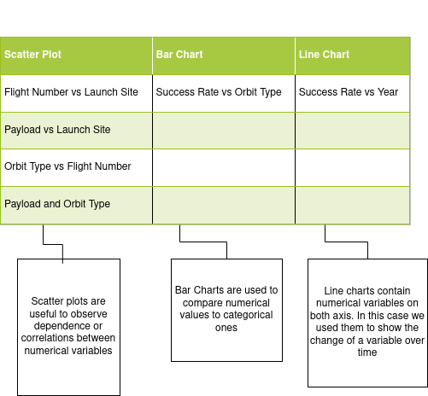
EDA with Data Visualization
https://github.com/albertoterranova/IBM/blob/main/4%20-%20EDA.ipynb

Slide 11
EDA with SQL
https://github.com/albertoterranova/IBM/blob/main/5%20-%20EDA_with_SQL.ipynb
1. Show names of unique launch sites
2. Show 5 launch sites whose name begins with ‘CCA’
3. Show the total payload mass carried by NASA’s boosters (CRS)
4. Show the average payload carried by Falcon9 v.1.1
5. List dates of first successful landing on ground pad
6. List the names of boosters landed on droneships and with payload mass between 4000 and 6000 kg
7. List the total number of successful and failed missions
8. List the name of boosters carrying the maximum payload mass
9. List the failed landing on drone ships, boosters name and launch site names for 2015
10. Rank the count of landings between 04/06/2010 and 20/03/2017

Slide 12
Build an Interactive Map with Folium
https://github.com/albertoterranova/IBM/blob/main/5%20-%20Folium.ipynb
All launch sites were displayed on a map using a folium map object by adding folium.Circle and folium.Marker for each site.
Many launches were performed on the same site, therefore we classified the successful and failed launches respectively with 1 and 0.
We proceeded by adding a folium.Marker to a MarkerCluster() object for each site. Colors were then assigned using the icon_color.
Great-circle distance was calculated between points using latitude and longitude coordinates extracted from the dataframe. Distances were drawn using the folium.Polyline method.

Slide 13
Build a Dashboard with Plotly Dash
https://github.com/albertoterranova/IBM/blob/main/7%20-%20spacex_dash_app.py
On the Potly Dash dashboard we displayed
1. Pie chart using the method px.pie(). This method allows the user to easily see the percentage of successful and unsuccessful launches. Using the dcc.Dropdown() method one manges to check for each individual site.
2. Scatter plot using the method pc.scatter(). This graph showed the dependence between payload mass in kg and the outcome of the landing. Using the RangeSlider() method, the user can extract infographics of the selected payload mass range.

Slide 14
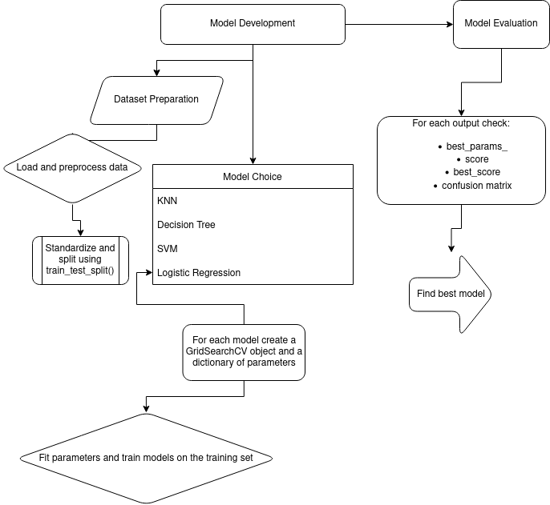
Predictive Analysis (Classification)
https://github.com/albertoterranova/IBM/blob/main/6%20-%20ML_Prediction.ipynb

Slide 15
Results
Exploratory data analysis results
Interactive analytics demo in screenshots
Predictive analysis results

Slide 16

Section 2

Slide 17
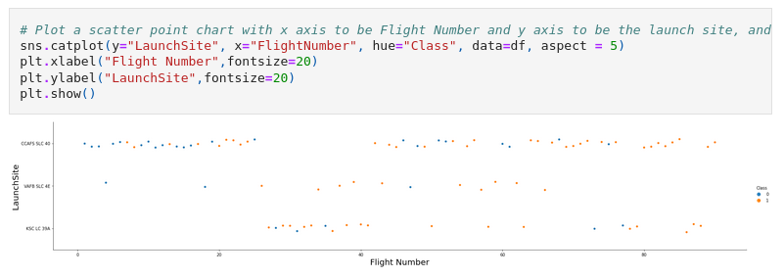
Flight Number vs. Launch Site
In general one can infer that with more launches the success rate increases.
For the first 30 launches almost all were deployed from the CCAFS SLC 40 station and most of them were unsuccessful.
The most successful site was KSC LC 39A, from where no early launches were performed.
Above the threshold of 30 launches, the success was significantly high.

Slide 18
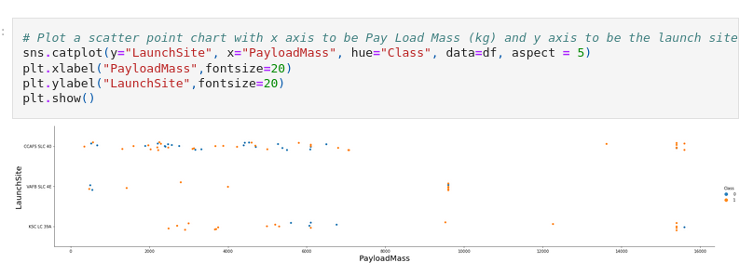
Payload vs. Launch Site
In general one cannot infer much from this scatterplot as it shows no clear correlation/dependence between payload mass and success rate.
Above 8000 kg of payload there are little unsuccessful launches yet the number of launches is too small to infer robust results.

Slide 19
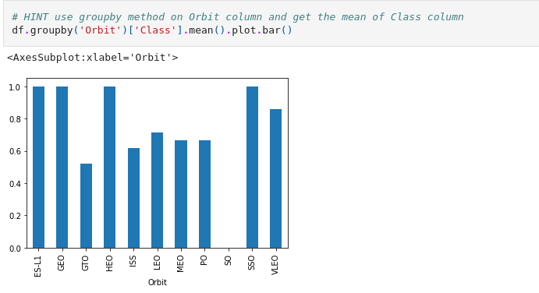
Success Rate vs. Orbit Type
- ES-L1,GEO,HEO,SSO have 100% success rate
- VLEO comes in second place with roughly 90%
- GTO,ISS,LEO,MEO,PO range between 50% and 70%
- SO performs poorly with a staggering 0% of success rate

Slide 20
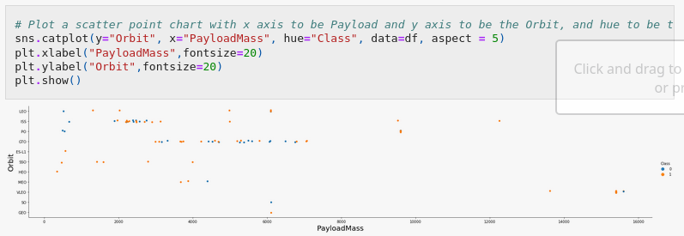
Flight Number vs. Orbit Type
From this scatterplot one can infer results regarding also the previous slide.
- The 100% success rate of GEO, HEO and ES-L1 is explained by having only one launch into their respective orbits.
- SSO has instead 100% on 5 flights
- We can easily see a positive correlation occurring between the number of flights and their success.

Slide 21
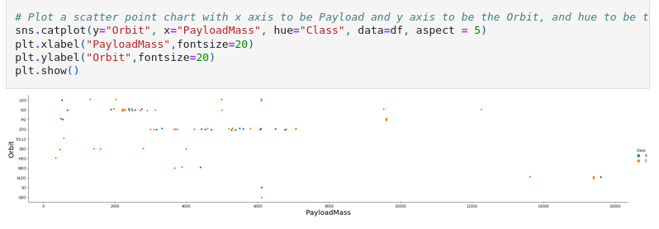
Payload vs. Orbit Type
- Almost all orbits performed well with payloads < 8000kg except SO and MEO
- PO,ISS and LEO show however few unsuccessful launches on light payloads
- GTO does not have a clear trend
- Above 8000kg only PO,ISS and VLEO were tested with positive results

Slide 22
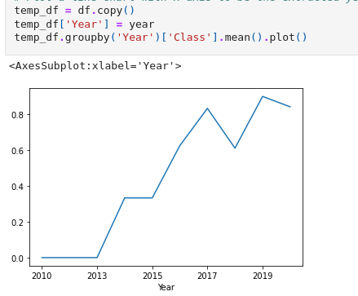
Launch Success Yearly Trend
This graph shows the exponential increase in successful launches.
- 2010-2013 all landings were unsuccessful
- After 2013 the success rate started increasing
- 2017 and 2019 marked two all time high in success topping almost 90% of all launches.

Slide 23
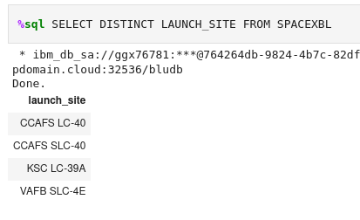
All Launch Site Names
- %sql is used to call the SQL extension on python
- DISTINCT is a builtin method of SQL that selects the unique values from a database

Slide 24
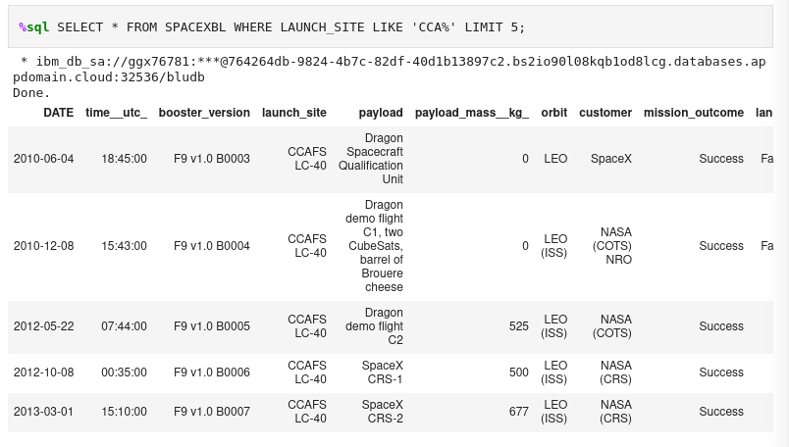
Launch Site Names Begin with 'CCA'
- Here we take all values
SELECT * FROM …
- We specify the column LAUNCH_SITE
- Filter using LIKE (case sensitive)
- in ‘CCA%’ the value % is used to take any string at its place
- LIMIT 5 is to take 5 rows

Slide 25
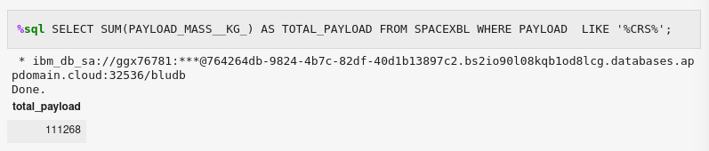
Total Payload Mass
- SUM() takes the sum of all rows in the chosen column, in this case PAYLOAD_MASS_KG
- Store the result in TOTAL_PAYLOAD
- ‘%CRS%’ is used to take all the payload whose name contain CRS

Slide 26
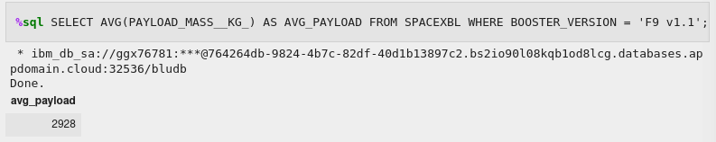
Average Payload Mass by F9 v1.1
- AVG() takes the average
- We select only the booster version ‘F9 v.1.1’

Slide 27
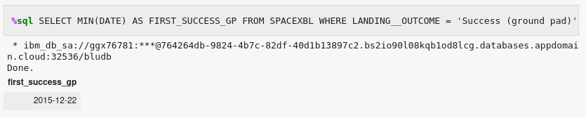
First Successful Ground Landing Date
- MIN(DATE) to select the first date
- Filter the landing on the ground using LANDING_OUTCOME = ‘Success (ground pad)’

Slide 28
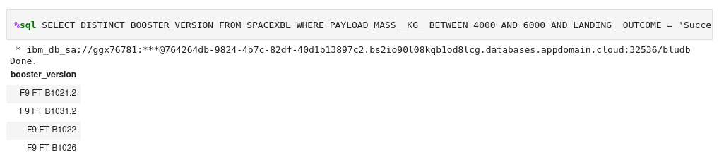
Successful Drone Ship Landing with Payload between 4000 and 6000
Here we select unique values of boosters versions and filter the mass using the function BETWEEN.
We further filter the landing outcome on the successful drone ship

Slide 29
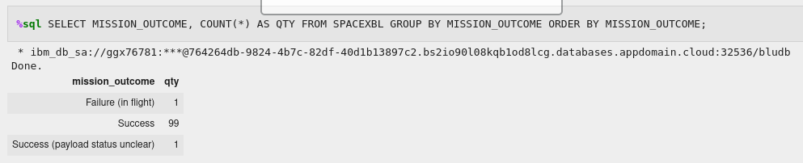
Total Number of Successful and Failure Mission Outcomes
- Extract mission outcome
- COUNT(*) counts the number of rows
- Group by mission_outcome intends to split the count into the subcategories of mission outcome
- Order by is used to rule the order of the dataset

Slide 30
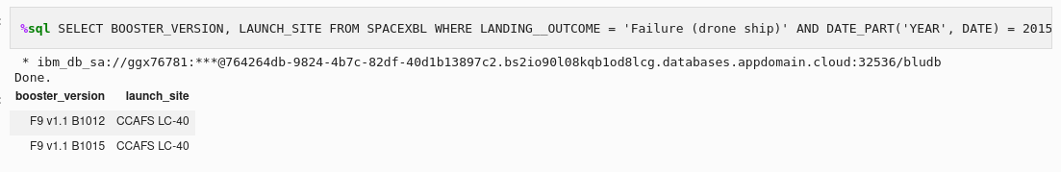
2015 Launch Records
Here we use the function DATE_PART(‘YEAR’,DATE) = 2015 to filter only for the year 2015 in the database.
Note that the function DATE_PART() returns a numeric value, e.g. DATE_PART(‘yy’,01/01/1999) yields as a result 1999.

Slide 31
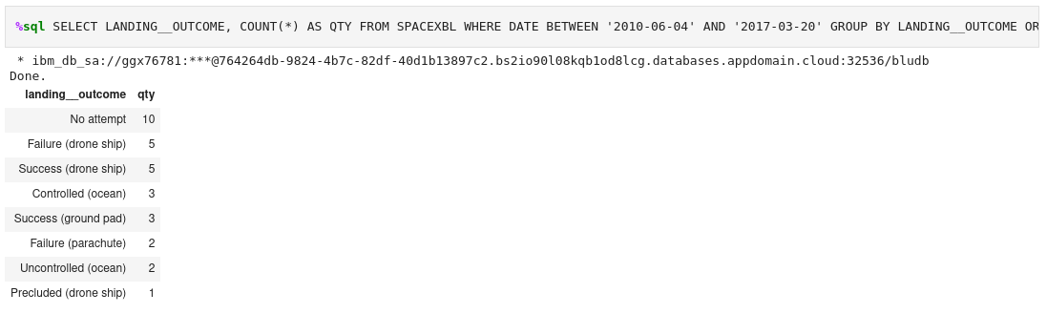
Rank Landing Outcomes Between 2010-06-04 and 2017-03-20

Slide 32

Section 3

Slide 33
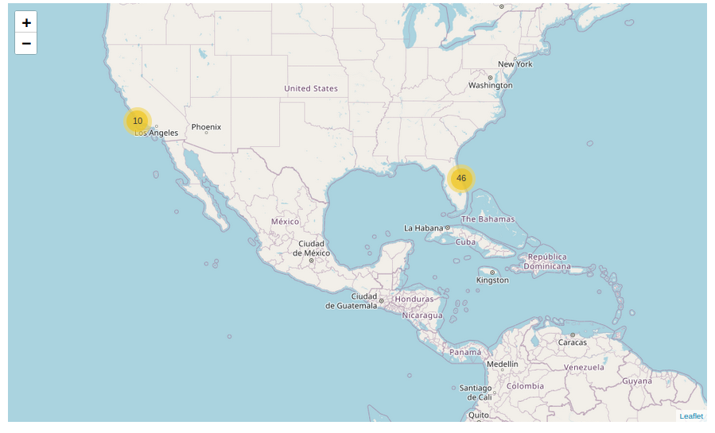
All Launch Sites
In the map we can see two launching sites with the yellow circle listing the number of launches

Slide 34
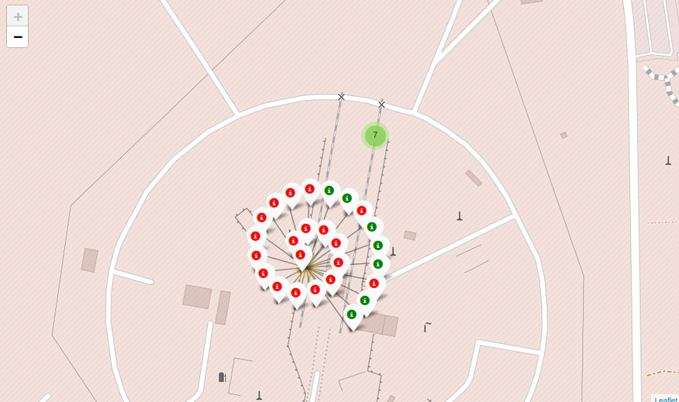
Successful/Failed launch for each site
If one clicks on the yellow marker, it will show the number of failed (red) and successful (green) launches for each site.
The marker was added on the map using the folium.Marker().
The white Icon was added using the folium.Icon(color=’white’,…) function

Slide 35
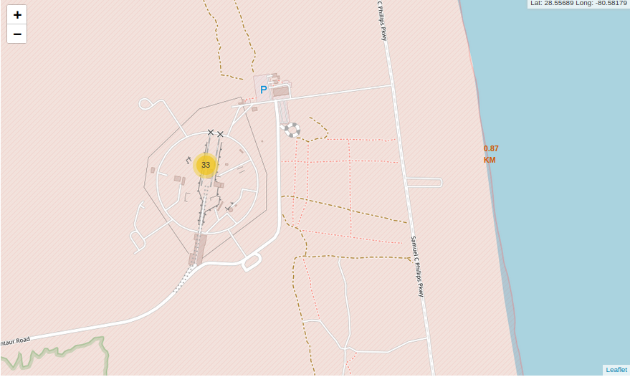
Distance to coastline
The red number 0.87 km is the shortest path to the coast line from the launch site.
It was calculated using the great-circle distance which is indeed the shortest path between two points.

Slide 36

Section 4

Slide 37
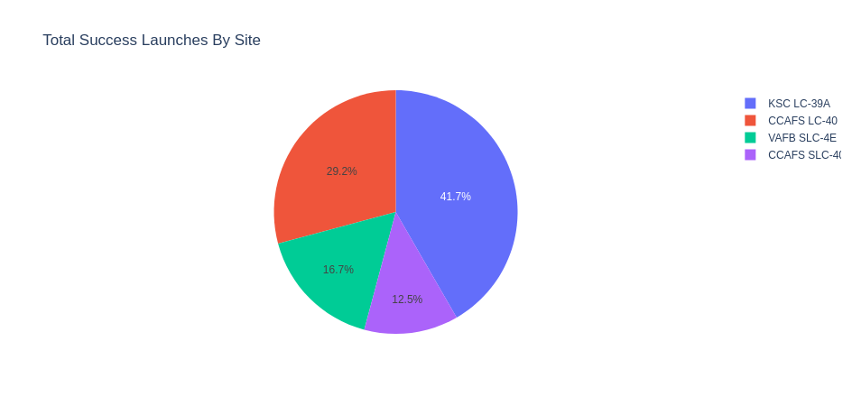
PIE CHART SPACEX – Counting Success
From the hovering menu one can see that this is the pie chart for all sites.
The site with most successes is the KSC LC 39 A with 41.7% overall successful launches coming from this site.
The plot was download using the widget download plot at the top right corner identified with a small camera.

Slide 38
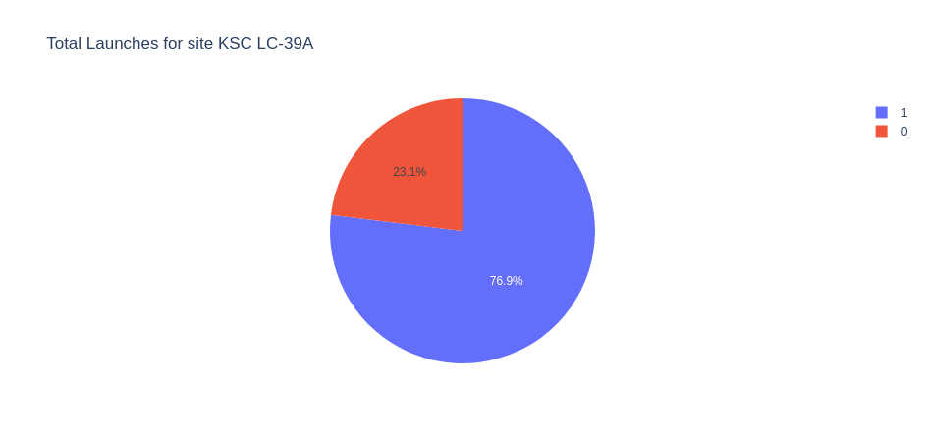
KSC LC-39A PIE CHART
In this figure we can see the pie chart with the highest success rate (76.9).

Slide 39
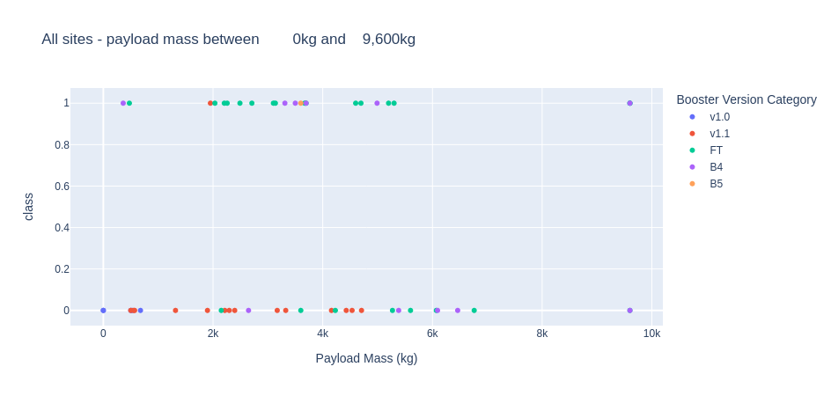
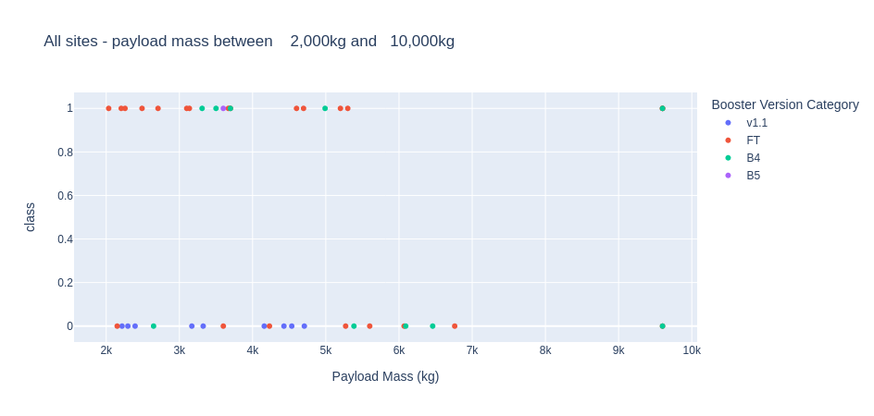
Payload vs Launch Outcome
In these plots we can see the outcome for each payload range in successful launches.
The figures show also the different booster versions.

Slide 40

Section 5

Slide 41
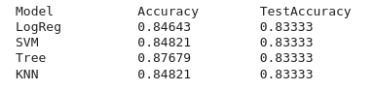
Classification Accuracy
The decision tree has the highest classification accuracy

Slide 42
Conclusions
More flights → More Accuracy
Launches seem to be independent of Payload Mass, however the threshold seem to be around 4000kg for successful launches
More Data on orbits are needed in order to infer conclusions
KSC LC-39 A is the most successful site
All classification model seem to perform equally well on the data, more models need to be tested though.

Slide 43


